Slide 1
Item/doc 7.3 – Environmental Sustainability
Third Session of the Infrastructure Commission
(INFCOM-3, 15-19 April 2024)
Shannon Kaya/Environmental Sustainability Focal Point
15 April 2024

Slide 2
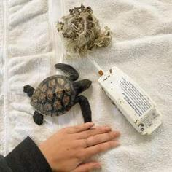
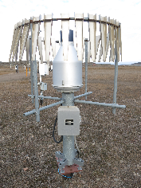
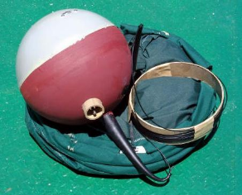
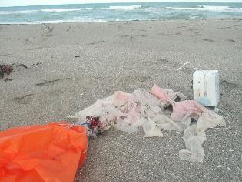
The way we measure weather and climate has environmental impacts…
National networks for observing weather and climate are designed to meet domestic and international requirements, within resource constraints
Some of the foundational observations in the production of critical weather and climate information are also the most environmentally impactful
Examples of observation methods, operational practices with environmental impacts
Radiosondes and ozonesondes
Marine drifter buoys
Oil/antifreeze mixtures used in precipitation gauges
Waste transportation and disposal
Use of mercury / Minamata convention
Site decommissioning
Credit: ECCC, J.Anderson
Credit: AU Seabird & Turtle Rescue
Credit: ECCC, P.Leibiuk
Credit: oceanmotion.org
Credit: balloonsblow.org
Credit: waterencyclopedia.com
…which have generally been accepted to meet the data requirements of users, applications, and services

Slide 3
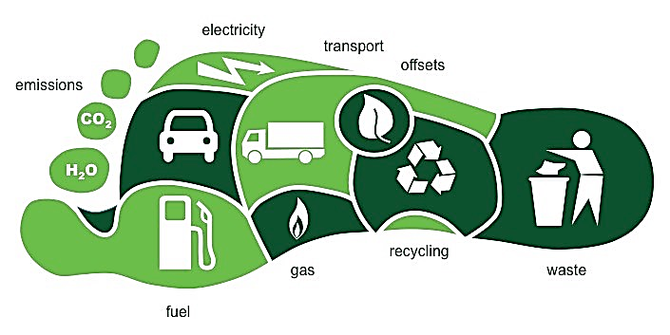
Organizations around the world are shifting to "greener" policies and practices…
GBON (WMO Global Basic Observing Network)
Establishes requirements for the spatial and temporal frequency of observations based on the needs of global numerical weather prediction
A trend towards greener operations that consider:
Innovative tech solutions
Renewable energies
Improved waste management
Green fleet management
Reduced plastic use
Reduced carbon footprint
Public awareness campaigns
Green procurement
INFCOM (WMO Commission for Observation, Infrastructure, and Information Systems)​
Has updated GBON guidance to include environmental sustainability considerations
…and the WMO has recognized the environmental impact of observing systems and practices

Slide 4
The international Focal Point coordinated plans and activities towards recommended amendments to WIGOS regulatory material
Observation domains
Meteorological
Hydrological
Atmospheric chemistry
Marine
Meteorological
Hydrological
Atmospheric chemistry
Marine
Advocacy theme
Influence policy and operations to consider environmental sustainability in decision making processes
Consider capacity development activities, incentive programs, training material and events
DOMAINS
Technical theme
Understand environmental impacts of current observing systems and operations and explore mitigation options
Assess new or emerging technologies and practices to complement existing systems and processed while reducing environmental impacts
Articulate technical solutions in support of environmentally sustainable observation technologies, methods, processes, standards
Collaborate with vendors to explore new business models and grow a competitive market

Slide 5
Since 2022, the Environmental Sustainability Initiative has achieved many positive outcomes…
Amendments to WMO Regulatory Material
International Benchmarking Survey Complete
International Presence at TECO, MTWE
Virtual International Workshop Hosted
SOFF Technical Specifications consideration
WIGOS Manual New Design Principle
Analysis of Members current, planned, and potential approaches to enhance the environmental sustainability of observations in meteorological, hydrological, atmospheric chemistry, and marine domains
Information sharing among stakeholders via presentations and focused discussions to establish common ground/baseline Day 1: Observing Systems
Day 2: Policies, Practices, and Standards
Presentations and panel discussions
Engagement with Members, industry representatives and the broader user community
…including reports published for the WMO Survey, Virtual Workshop, and TECO/MTWE

Slide 6
The WMO Strategic Plan for 2024-2027 provides a backdrop for continued collaboration and progress under the guidance of INFCOM
Goal 2: Enhance Earth system observations and predictions: Strengthening the technical foundation for the future
Objective 2.1: Optimize the acquisition of Earth system observation data through the WMO Integrated Global Observing System (WIGOS)
Environmentally sustainable design of WMO observing programmes ensured
Goal 5: Strategic realignment of WMO structure and programmes for effective policy- and decision-making and implementation
Objective 5.4: Environmental sustainability
Develop, publish and initiate implementation of a plan to achieve Net Zero, to include green and effective travel, green building, green IT and green supply chains

Slide 7
INFCOM-3 Decisions
INFCOM-3/Doc. 7.3
To follow a balance approach between delivering on core mandate and implementing environmentally sustainable approaches
Balanced Approach
To recognize Members’ need for guidance material on environmentally sustainable practices
Guidance
To recognize the importance of cooperating with industry on observing systems and methods
Cooperation
To establish a Study Group on Environmental Sustainability (SG-EnvS)
Dedicated Resources
To request all INFCOM SCs and AGs to take environmental sustainability into account
Regulations

Slide 8
WMO Study Group on Environmental Sustainability (SG-EnvS)
SG-EnvS Membership
Chair/Co-chairs
Standing Committees
Advisory Groups
HMEI
Other Study/ Advisory Groups
Additional Experts
Expertise in WIGOS, WIS and/or WIPPS
One rep from each
One rep from each
One representative
To represent all domains/activity areas
To ensure appropriate gender and regional diversity
Deliverables to INFCOM:
Develop a roadmap to address the environmental sustainability goals stated in the WMO Strategic Plan with respect to INFCOM activities, including:
Recommendations on how to minimize the environmental impact of WIGOS, WIS and WIPPS systems;
List of activities related to environmental sustainability to be conducted by INFCOM during its next intersessional period (2026–2027);
Conduct workshops to share best practices, exchange ideas, and develop collective strategies;
Collect best practices related to reducing the environmental impact of WIGOS, WIS and WIPPS and share with Members;
Work with the representative of each Standing Committee and Advisory Group to ensure appropriate teams are tasked and/or established to follow-up on proposed activities for 2026–2027 onwards.

Slide 9
Thank You

